Slide 1

Data Warehouse Project of
Financial Companies
That Issued PPP Loan
Christian Sierra Perez,
Ziqi Polimeros,
Tiffany Tran

Slide 2
Team Members
Christian Sierra Perez - Project Manager
Ziqi Polimeros - Senior Data Analysis
Tiffany Tran - Data Analysis

Slide 3
Background
The Paycheck Protection Program (PPP) is a $953-billion business loan program
Established by the government during the Trump administration in 2020 through the CARES Act (Coronavirus Aid, Relief, and Economic Security)
Intended to help certain nonprofit organizations and businesses, self employers, sole proprietors, and tribal businesses
Program allows them to apply for low-interest loans for payroll and other costs
The loan for each applicant was approximately 2.5 times the average monthly payroll costs
Some applicants received a second loan, typically similar to the first one to cover other costs (rent, interest, utilities, etc.)
Can be partially forgiven if the business keeps employee counts and wages stable

Slide 4
Users Benefits
Enhanced data quality and consistency
Provides a stable and central repository of all the data
Improves business processes and decision making
Provides insights on the different small business that were affected by covid-19
Allows users to see
The effect of the PPP loan on the businesses
The different outcomes that came about the loan
The financial impact before and after the loans
Helps users come to conclusions about the different factors that may be affecting the business
Ultimately help to make decisions based on the information revealed from the data

Slide 5
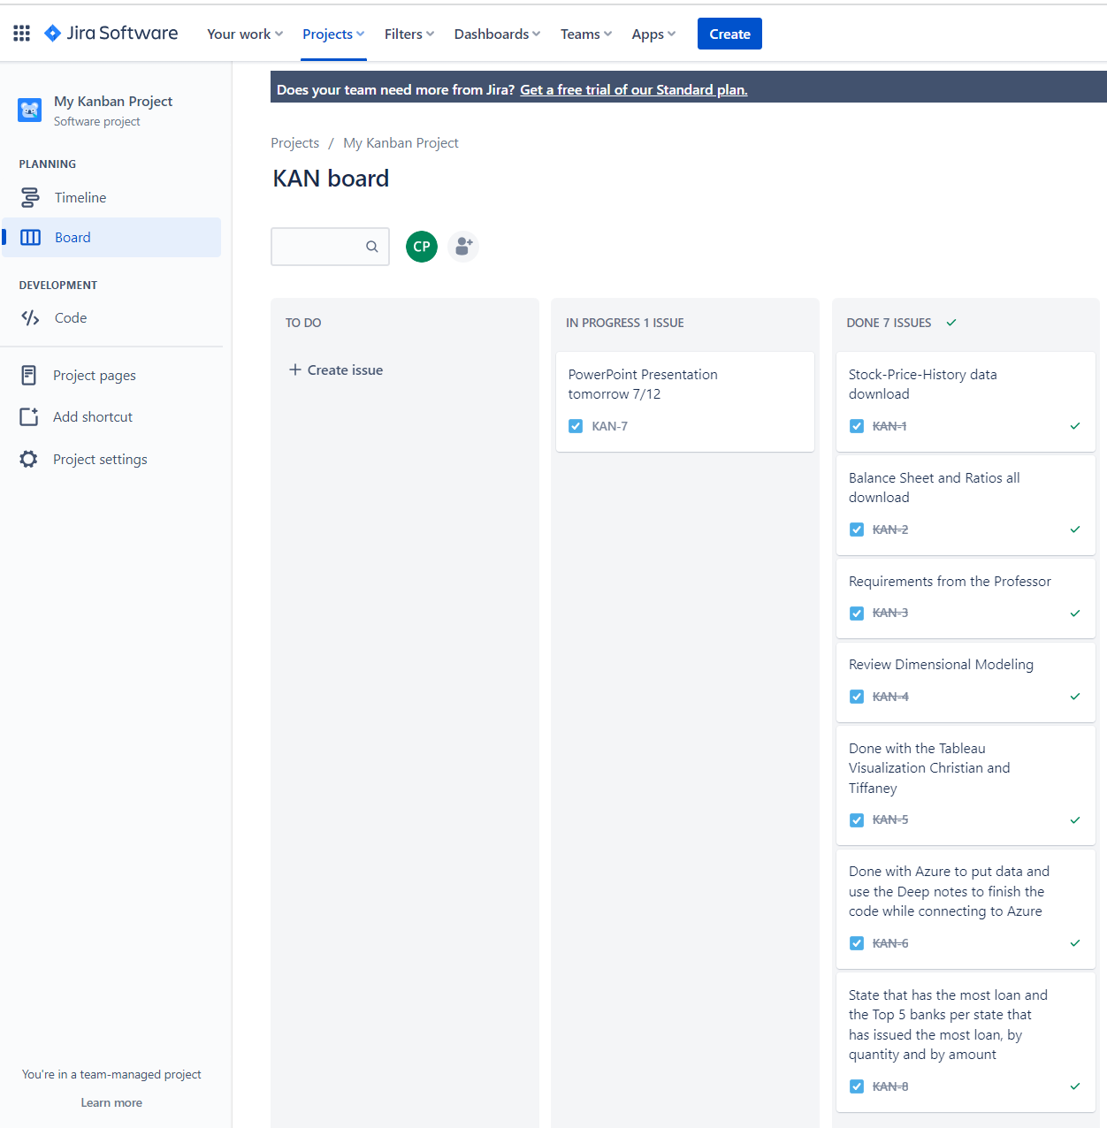
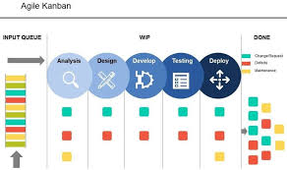
Kanban Methodology
Kanban Methodology is an agile method that aims for continuous improvement, task management flexibility, and improved workflow.

Slide 6
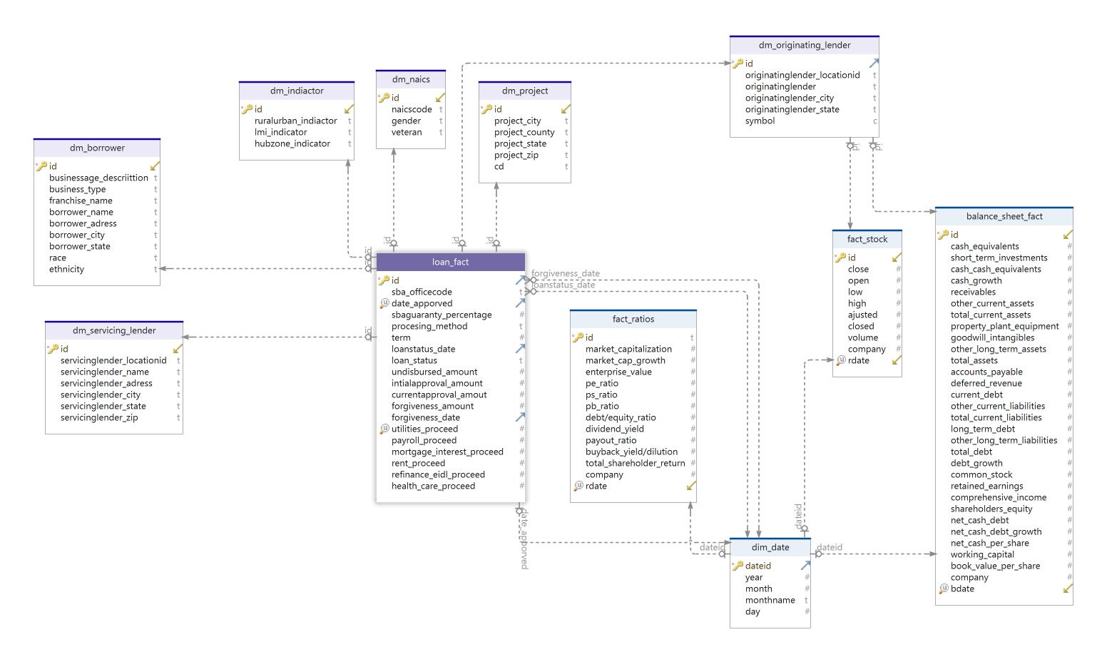
Dimensional Modeling

Slide 7
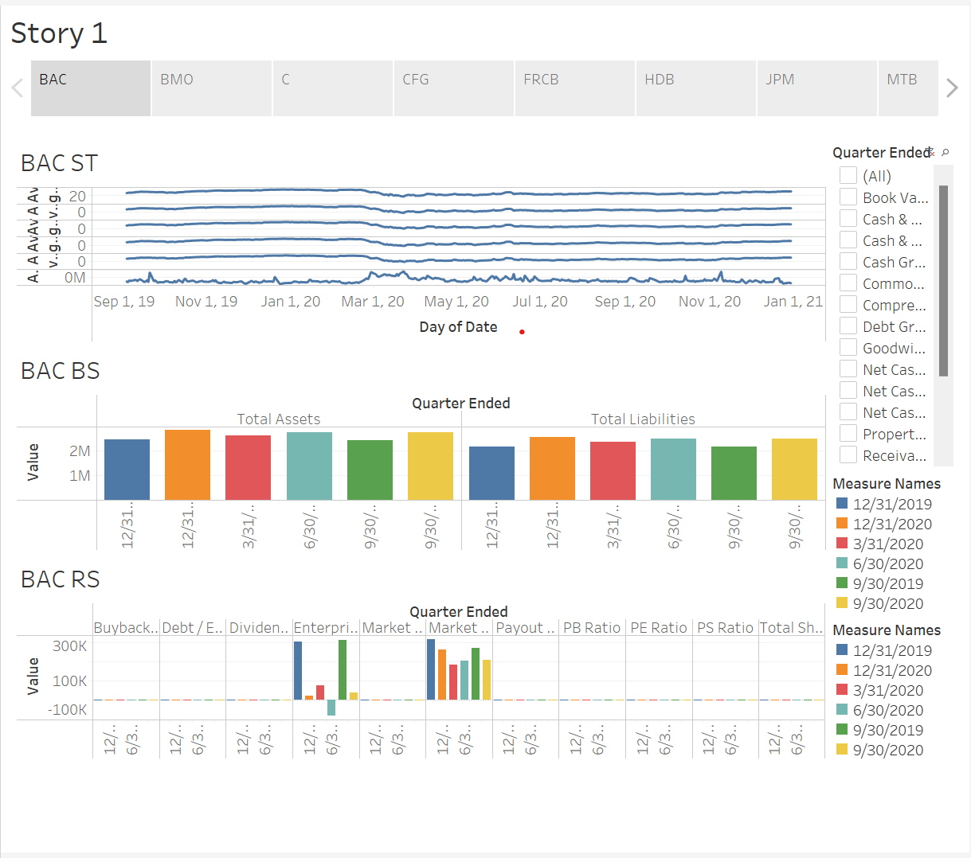
Tableau Visualization
Stocks:
By Day
Average
Balance Sheet:
By Total Assets
By Total Liabilities
Ratios:
PB Ratios
PE Ratios
PS Ratios
ETC

Slide 8
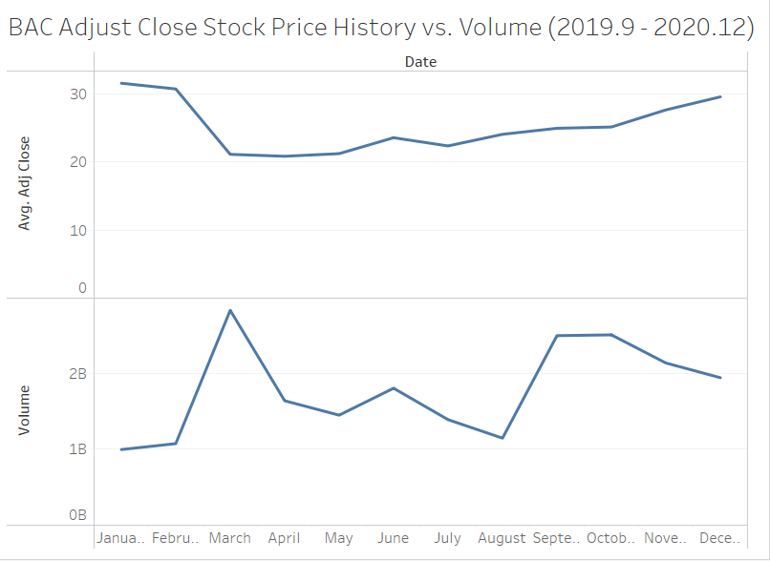
Data Visualization – Stock Price
Data Source:
Yahoo Finance.
Data Extraction:
Web scraping through Python
Data Transformation:
Data cleaning, data filtering, data analysis.
Data Storage: Azure

Slide 9
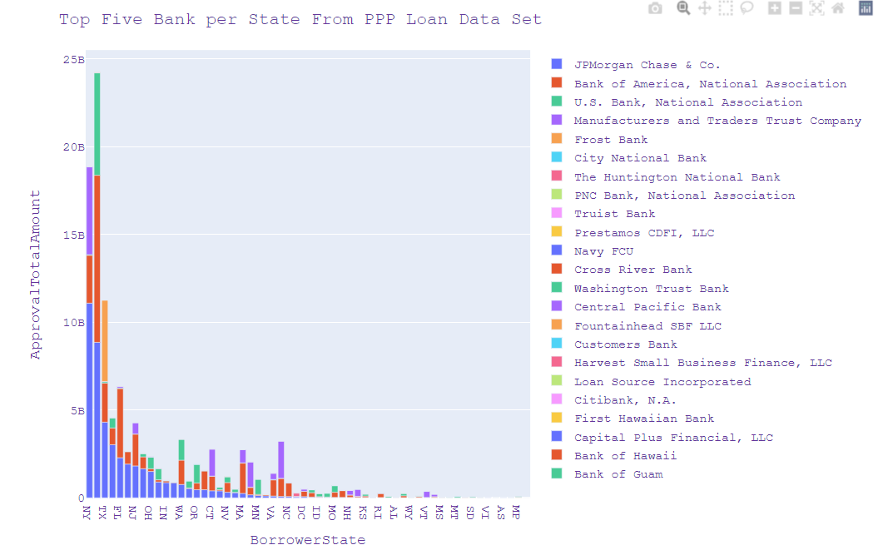
Data Visualization – PPP Loan

Slide 10
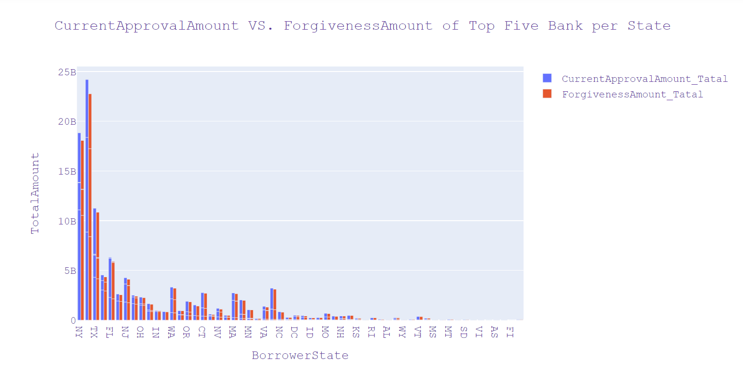
Insight

Slide 11
Future Work
Data Maintenance and Update;
Real-time Update
Increase Company Options
Test and Validate
Deploy and Monitor
Ensure Data Security and Privacy

Slide 12
List of Links for Our Term Project
Github Link:
https://github.com/Christ244/CIS4400
Deepnotes Link: https://deepnote.com/workspace/cis4440-af30dd6c-7034-49d4-8ffd-f5f64dc5d870/project/KXW-ca436d51-26cb-4a7b-9af3-0ce82bc99b1b/notebook/christian_tiffany_ziqi-28eecb5ebd224e84830d08c034d50ea3
Project Powerpoint: https://docs.google.com/presentation/d/1KXKwsI8TYJ0FEIYt7-qRqH4FOfVE9nB4tE4OsMCjMhQ/edit?usp=sharing

